Slide 1

EE(IM) 4080 Final Year Project
Associate Professor Arokiaswami Alphones
FYP Committee Chairman
August 18, 2023

Slide 2
Briefing Outline
Introduction
Important Timelines
FYP Assessments
Budget and Reimbursement

Slide 3
Introduction
Every EEE final year students are required to undertake a project supervised by one or two EEE faculty members.
FYP will spread over one academic year (2 semesters) for full-time students / one and a half year (3 semesters and a special term) for part-time students.
No extension is allowed except for approved semester leave for students who have completed the first semester of the FYP.
Students who apply semester leave in the first semester of the FYP, their FYP will be de-registered.
Add/drop is ONLY allowed during the add/drop period:
Full-Time students: 11 to 25 August 2023 (by 10pm)
Part-Time students: 11 to 18 August 2023 (by 10pm)
Main supervisors can modify project title/summary from teaching week 1.

Slide 4
Important Timelines for FYP starting in AY2023 / 2024 Semester 1
S/N | Tasks | Full-Time FYP (Aug 2023 – May 2024) | Part-Time FYP (Aug 2023 – Dec 2024)
1. | Project Plan / Strategy | 18 Sep 2023 | 18 Sep 2023
2. | Interim Report & Video Presentation | 14 Nov 2023 | 19 Feb 2024
3. | Draft Final Report | 28 Mar 2024 | 25 Oct 2024
4. | Final Report | 12 Apr 2024 | 08 Nov 2024
5. | Project Demonstration | 15 - 19 Apr 2024 | 11 - 15 Nov 2024
6. | Oral Presentation | 13 - 15 May 2024 | 09 Dec 2024
7. | Full-Text report | 22 May 2024 | 16 Dec 2024
8. | Final Report (revised after oral) | 22 May 2024 | 16 Dec 2024

Slide 5
FYP Assessments
Interim Assessments
Project Plan/Strategy – Submit to Supervisor
Interim Report & Video Presentation – Submit to both Supervisor and Examiner
Main Assessments
Project Final Report – Submit to both Supervisor and Examiner
Project Demonstration – To Examiner after report submission
Oral Presentation – To both Supervisor and Examiner

Slide 6
Interim Assessments
Project Plan / Strategy
Describe the project’s main objectives, background, action plan and propose a weekly schedule in chart form.
Interim Report
Reiterate project plan/strategy and elaborate project’s progress, tasks completed, results obtained as well as potential issues identified.
Video Presentation
In a 2-3 minutes video, tell a story of your project. Introduce the project concept, background and elaborate results obtained.

Slide 7
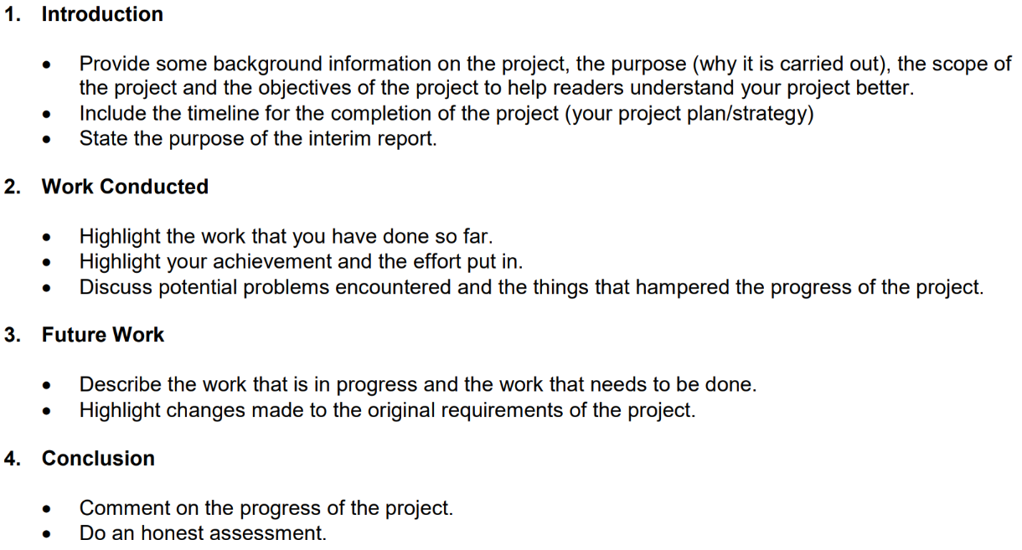
Interim Assessments
Interim Report Suggested Format

Slide 8
Main Assessments
Final Report
Conduct literature review, focus on the main issues, identify key tasks, validate the problem statement through analytical studies, experiments etc., discuss the results and suggest future work.
Write a report and present the work.
Project Demonstration
Provide project demonstration to examiner. If project demonstration is not possible, examiner(s) will conduct interview to assess student’s understanding to the work.
Oral Presentation
25 minutes (15 mins of student’s presentation and 10 mins of Q&A).

Slide 9
Main Assessments
Final Report Format
To maintain consistency, all students are required to follow the same format for preparing final reports.
Cover Page
Table of Contents
Abstract (not more than one page)
Acknowledgements to give recognition of any assistance received during your FYP process (optional)
Acronyms (optional)
Symbols (optional)
List of Figures
List of Tables
Main chapters (Chapter 1, Chapter 2………)
Discussion/Conclusion
Reflection on Learning Outcome Attainment
References
Appendix (optional)

Slide 10
Main Assessments
Reflection on Learning Outcome Attainment is compulsory as it is part of the final report and accreditation requirements.
Reflect your FYP experience and achievements by addressing at least three of the points below:
Engineering knowledge
Problem Analysis
Investigation
Design/development of Solutions
Modern Tool Usage
The Engineer and Society
Environment and Sustainability
Ethics
Individual and Teamwork
Communication
Project Management and Finance
Lifelong Learning

Slide 11
After Oral Presentation
Final Report (revised after oral)
Any revision, AFTER the oral, to the final report, you’ll need to resubmit to Turnitin for plagiarism check, then send to supervisors.
Full Text Report to Library
Submit full-text FYP report (softcopy) to the library through Digital Repository @ NTU

Slide 12
Project Assessment
All FYP reports (interim report, draft and final reports) must be submitted to Turnitin service to check for plagiarism, where the service produces a similarity score and originality report.
NTULearn course site will be created for students to submit the FYP report for Turnitin checking.
A minimum CGPA of 4.50 and at least a 'B+' grade for the Final Year Project (FYP), are required for the award of an Honours (Highest Distinction) degree.

Slide 13
Budget and Reimbursement
Amount allocated for FYP:
Full-time students: up to $400 / project (excluding GST)
Part-time students: up to $500 / project (excluding GST)
Items available in the lab are not allowed to purchase, you can check the item availability in the shared folder or respective lab staff.
For full-time students, you are advised to consolidate your claims amount to > = $200 and submit under one ICS submission.
List of FYP Consumables Claimable and Non-Claimable can be found in EEE FYP website (QR code will be shared in the last slide).

Slide 14
Reimbursement Procedure
The procedure can be found in EEE FYP website (QR code will be shared in the last slide).
START
Items listed under claimable?
YES
NO
Submit items to be purchased to the respective lab staff via email. The email MUST include:
1) Declaration that items are not available for loan in the common store.
2) Declaration that items are not listed under non-claimable
3) Amount, including this purchase, has NOT exceeded the amount allocated.
4) Items to be purchase with the costing.
5) Justification of purchase purposes.
(**Students are required to attach the email for the subsequent approval and ICS)
Submit items to be purchased to the respective lab staff via email. The email MUST include:
1) Declaration that items are not available for loan in the common store.
2) Declaration that items are not listed under non-claimable
3) Amount, including this purchase, has NOT exceeded the amount allocated.
4) Items to be purchase with the costing.
5) Justification of purchase purposes.
(**Students are required to attach the email in ICS)
NO
FYP supervisor recommends?
YES
NO
*FYP Chairman recommends?
YES
Submit claims online to Integrated Claims System (ICS) via StudentLink.
Students proceed to purchase items
END
All items must be returned to the laboratories BEFORE the FYP oral presentation.

Slide 15
Useful Information and Guidelines
Check your NTU emails regularly.
Visit EEE FYP website for guidelines, schedules, report templates, and reimbursement information:
Student intranet > Colleges & Schools > CoE > School of EEE > Programmes > Undergraduate Programmes > B.Eng (Full-Time) / B.Eng (Part-Time) > Course Information > Final Year > Final Year Project
Or simply scan the QR code in the last slide.

Slide 16
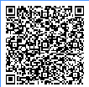
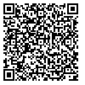
Q & A
For any enquiries, feel free to email us.
eeeundgrad@ntu.edu.sg (full-time students)
eeept@ntu.edu.sg (part-time students)
EEE Full-Time FYP
EEE Part-Time FYP

